Slide 1
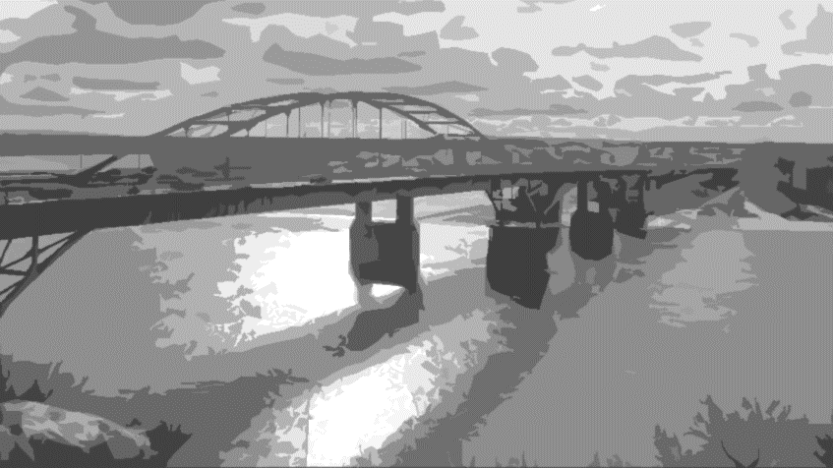
Visual Analysis of Defects
Aleksandr Amirkhanov

Slide 2


Slide 4


Slide 5
What Is a Defect?

Slide 6
Defect
Medicine
Industry
Chemistry
Service
Geometry
Product
Failure to warn
Product liability
Dangerous
Product recall

Slide 7
ISO 9000
defect
nonconformity related to an intended or specified use
↕
nonconformity
non-fulfilment of a requirement
↕
requirement
need or expectation that is stated, generally implied, or obligatory
↕
quality
degree to which a set of inherent characteristics of an object fulfils requirements

Slide 8
Z
Spatial defects
(x, y, z)
Y
X

Slide 9
X
Spatial defects
Temporal defects
Time

Slide 10
X
Spatial defects
Temporal defects
Spatiotemporal defects
Z
Z
Z
(x, y, z)
(x, y, z)
(x, y, z)
Y
Y
Y
X
X
X
Time

Slide 11
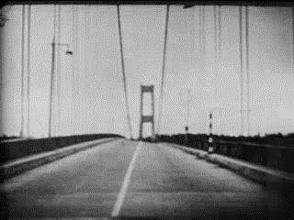
Spatial defects
Temporal defects
Spatiotemporal defects
Design space defects
Design space
Extreme weather
Object parameters
Wind
Thunder
Weight
Frost
Strength
Earthquake
Materials
Flood
Cost
Conflagration
Aesthetics
…

Slide 12
How to Control Defects?

Slide 13
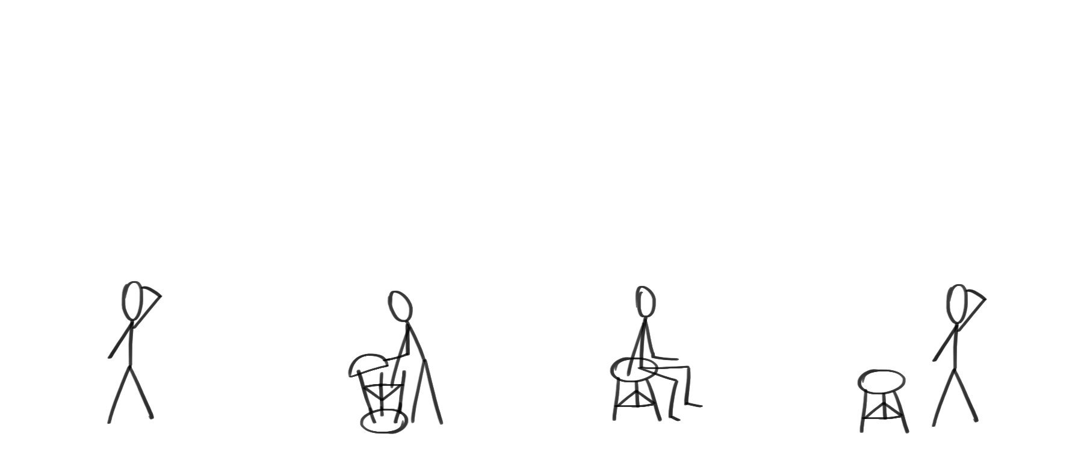
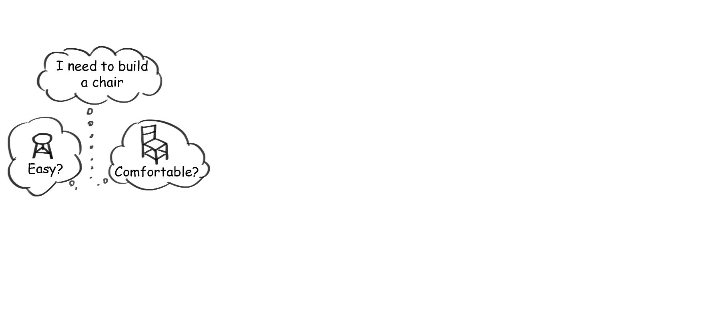
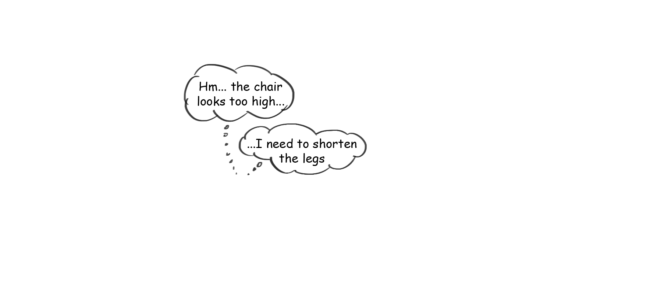
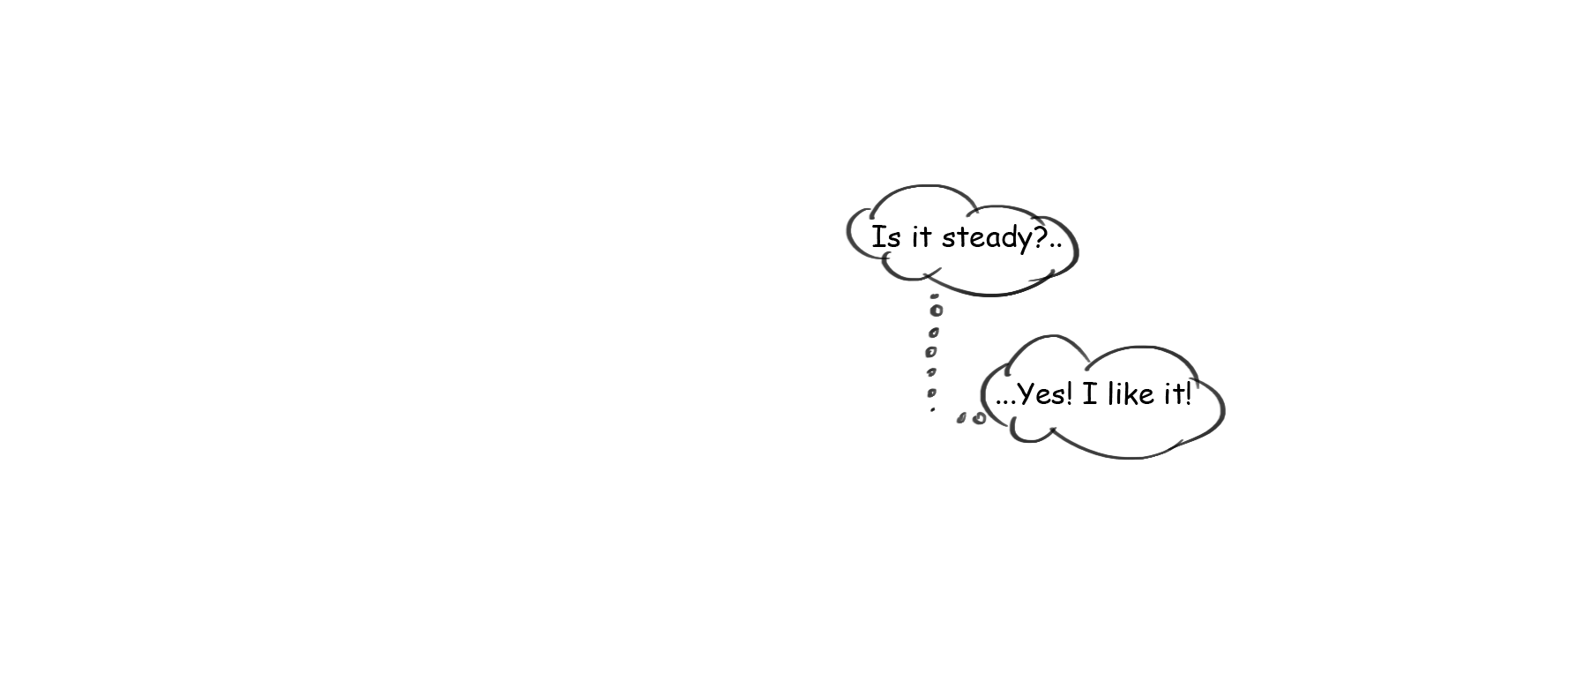
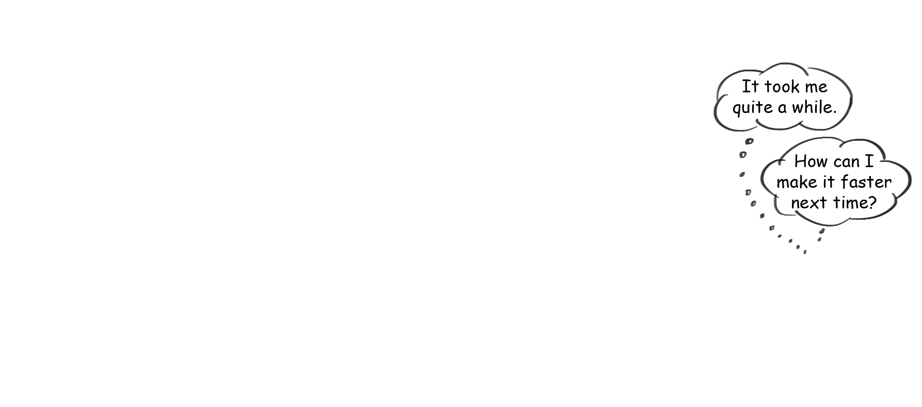
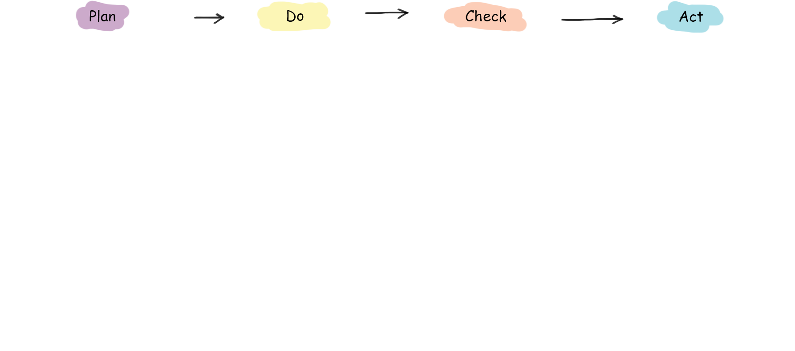
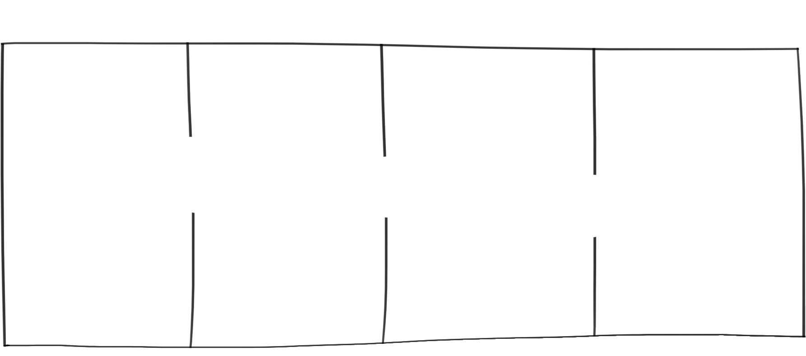





Slide 14
Plan-do-check-act cycle

Slide 15
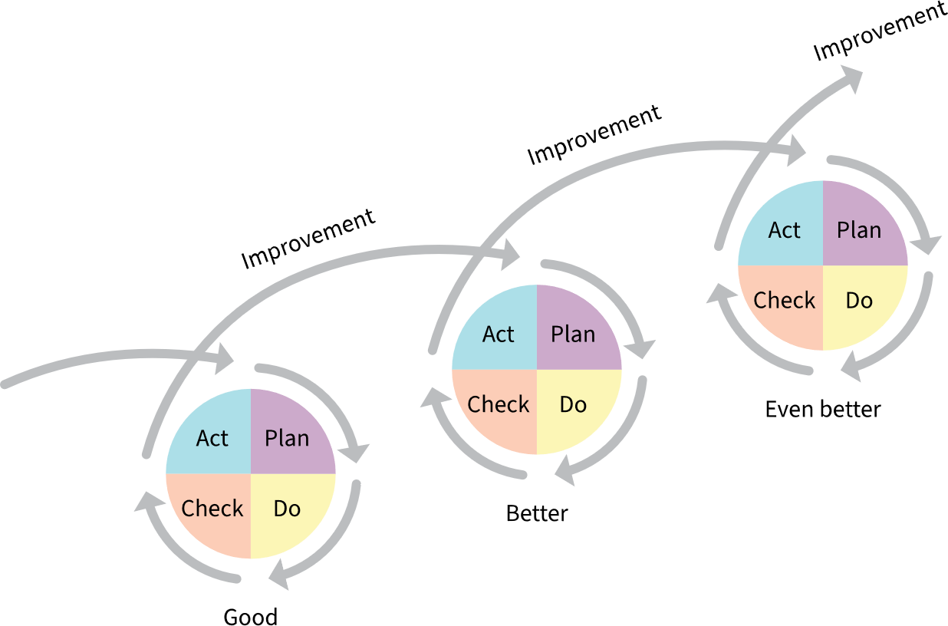
Plan-do-check-act cycle

Slide 16
Defect analysis
Improvement
Defect prevention
Act
Plan
Check
Do
Performance
evaluation
Control of defective
outputs

Slide 17
How to Visually Support Defects Analysis?

Slide 18
“Visualization is a method of computing. It transforms the symbolic into the geometric […]. Visualization offers a method for seeing the unseen. […]”
McCormick et al.

Slide 19
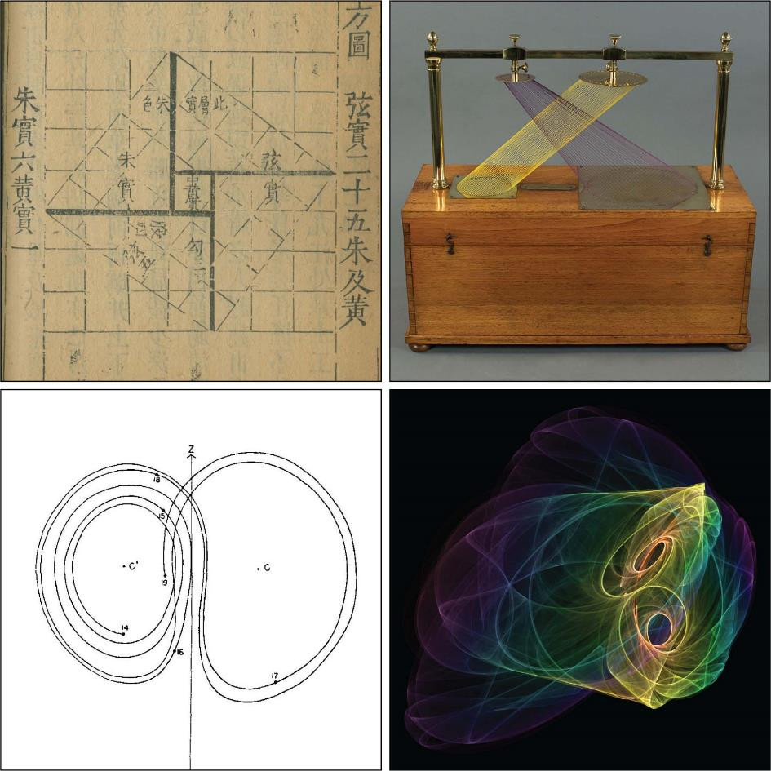
3rd century CE
ca. 1830–1845
1963
present

Slide 20
“Visual analytics is the science of analytical reasoning facilitated by interactive visual interfaces.”
Thomas and Cook

Slide 21




Analytical reasoning and
knowledge discovery
Visual representations
Large, complex, dynamic data
Interplay between human and machine
Automatic analysis
techniques
Knowledge externalization
and dissemination
Data representations
Interactive visualizations

Slide 22
Visual Analysis of Defects

Slide 23
Defect analysis
Visual analytics
+

Slide 24
Visual analysis of defects

Slide 25
Research Aim

Slide 26
“Investigate strategies supporting the visual analysis of defects within the
four steps of defect prevention, control of defective outputs, performance evaluation, and improvement.”

Slide 27
[Obj1] Identify relevant visualization and visual analytics strategies
[Obj2] Design and develop novel strategies
[Obj3] Describe how the visual analysis of defects addresses different types of defects

Slide 28
Contributions

Slide 29
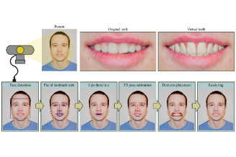
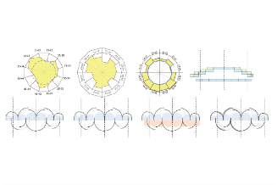
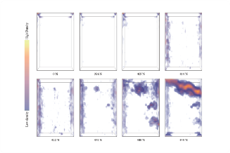
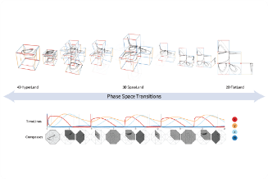
Paper A: “WithTeeth: denture preview in augmented reality,” in Vision, Modeling and Visualization
Paper B: “Visual analytics in dental aesthetics,” Computer Graphics Forum
Paper C: “Visual analysis of defects in glass fiber reinforced polymers for 4DCT interrupted in situ tests,” Computer Graphics Forum
Paper D: “Manylands: A journey across 4D phase space of trajectories,” Computer Graphics Forum

Slide 30
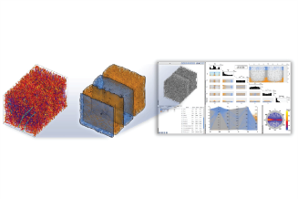
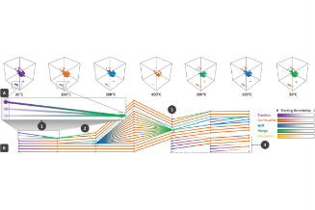
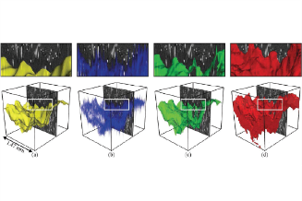
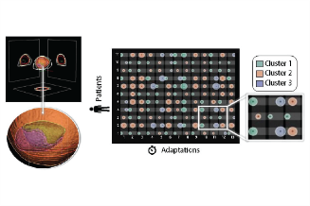
“FiberScout: an interactive tool for exploring and analyzing fiber reinforced polymers,” in 2014 IEEE Pacific Visualization Symposium
“Fuzzy feature tracking: visual analysis of industrial 4D-XCT data,” Computers & Graphics
“Comparison of final fracture extraction techniques for interrupted in situ tensile tests of glass fiber reinforced polymers,” in 7th Conference on Industrial Computed Tomography
“Bladder Runner: Visual analytics for the exploration of RT-induced bladder toxicity in a cohort study,” Computer Graphics Forum

Slide 31

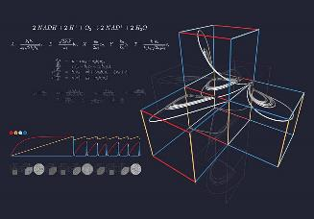

“Processing, Analysis and Visualization of CT Data in Industrial X-Ray Computed Tomography,” In Industrial X-Ray Computed Tomography
VCBM Image Contest Award
“Visualization Working Group at TU Wien: Visibile Facimus Quod Ceteri Non Possunt,” Visual Informatics

Slide 32
Related Work

Slide 33
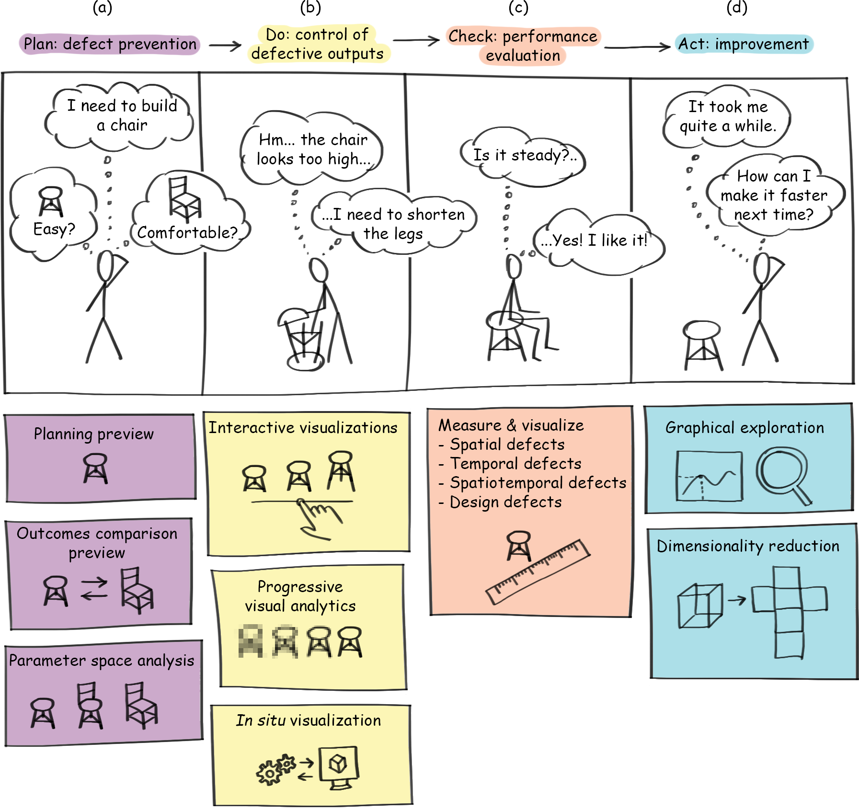

Slide 34

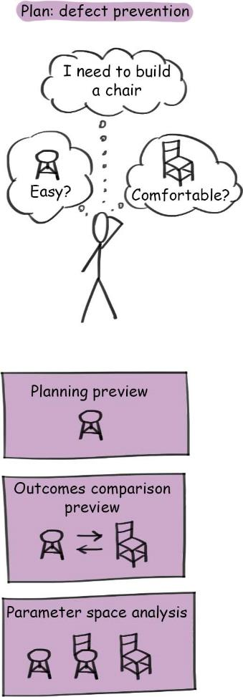
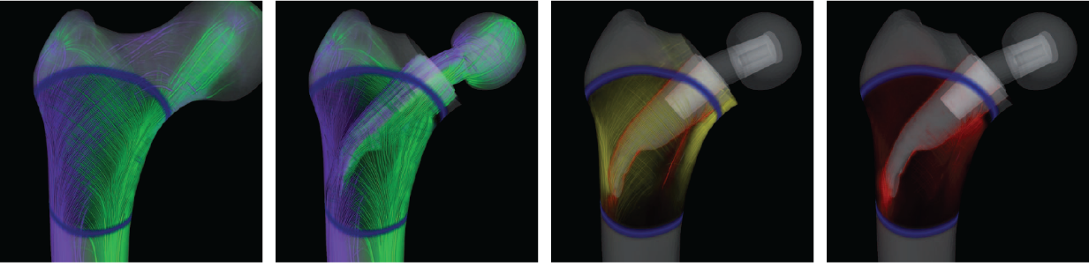
C. Dick et al, “Stress tensor field visualization,” TVCG, 2009

Slide 35
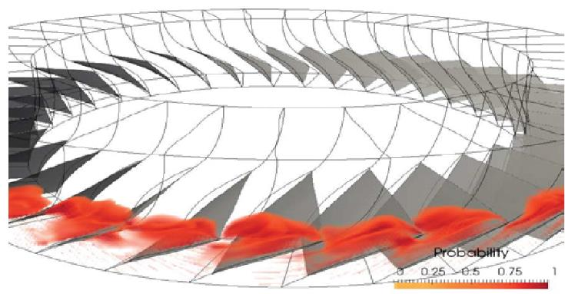
S. Dutta et al “In situ distribution guided analysis and visualization of transonic jet engine simulations,” TVCG, 2016

Slide 36
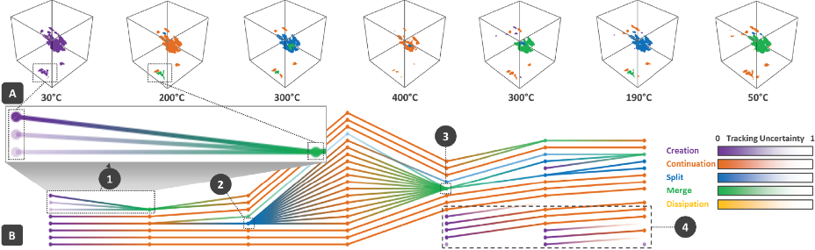
A. Reh et al “Fuzzy feature tracking: Visual analysis of industrial 4D-XCT data,” C&G, 2015

Slide 37
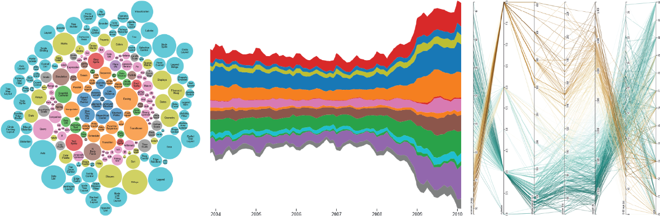
d3.js library examples

Slide 38
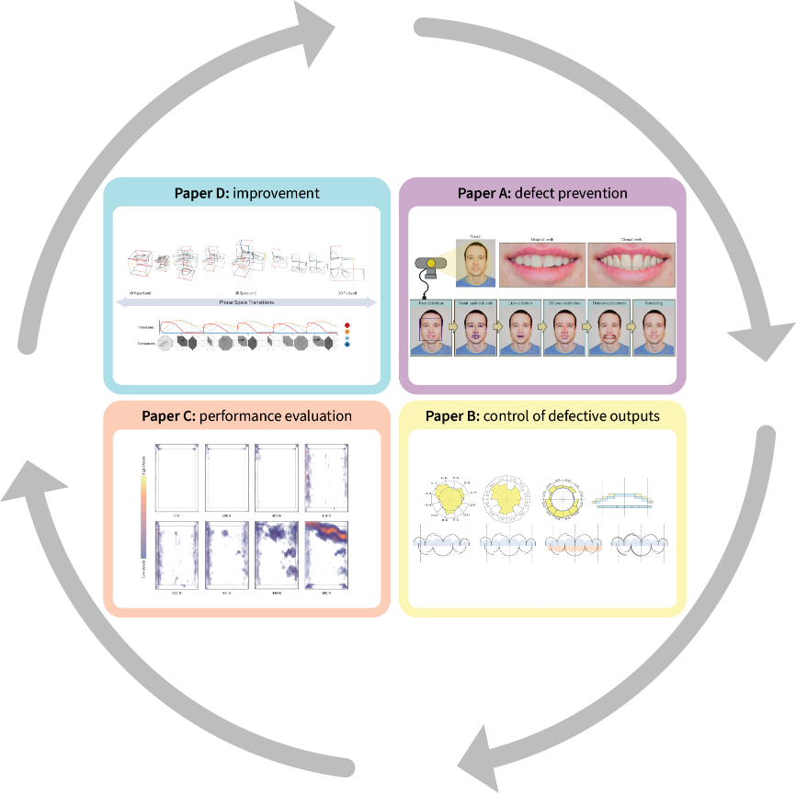

Slide 39
Defect Prevention

Slide 40
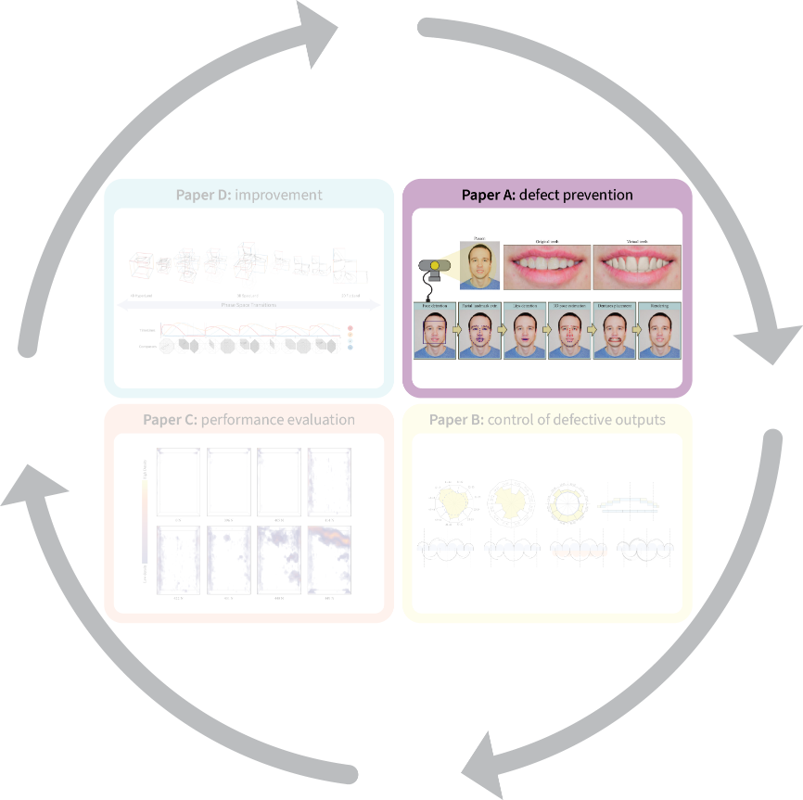
“WithTeeth: denture preview in augmented reality,”
in Vision, Modeling and Visualization

Slide 41
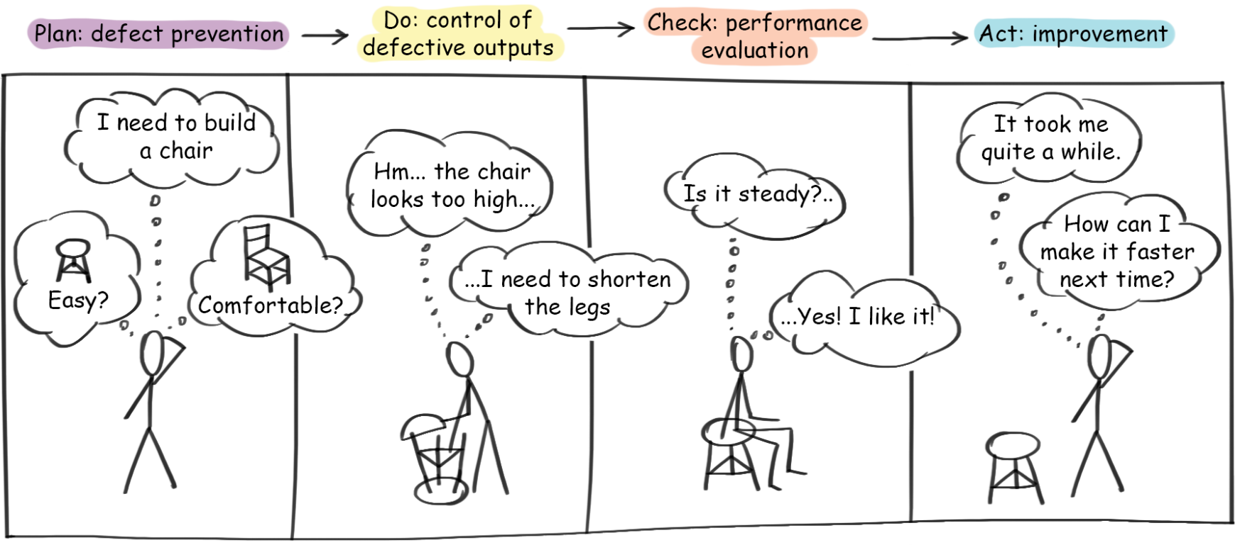

Slide 42
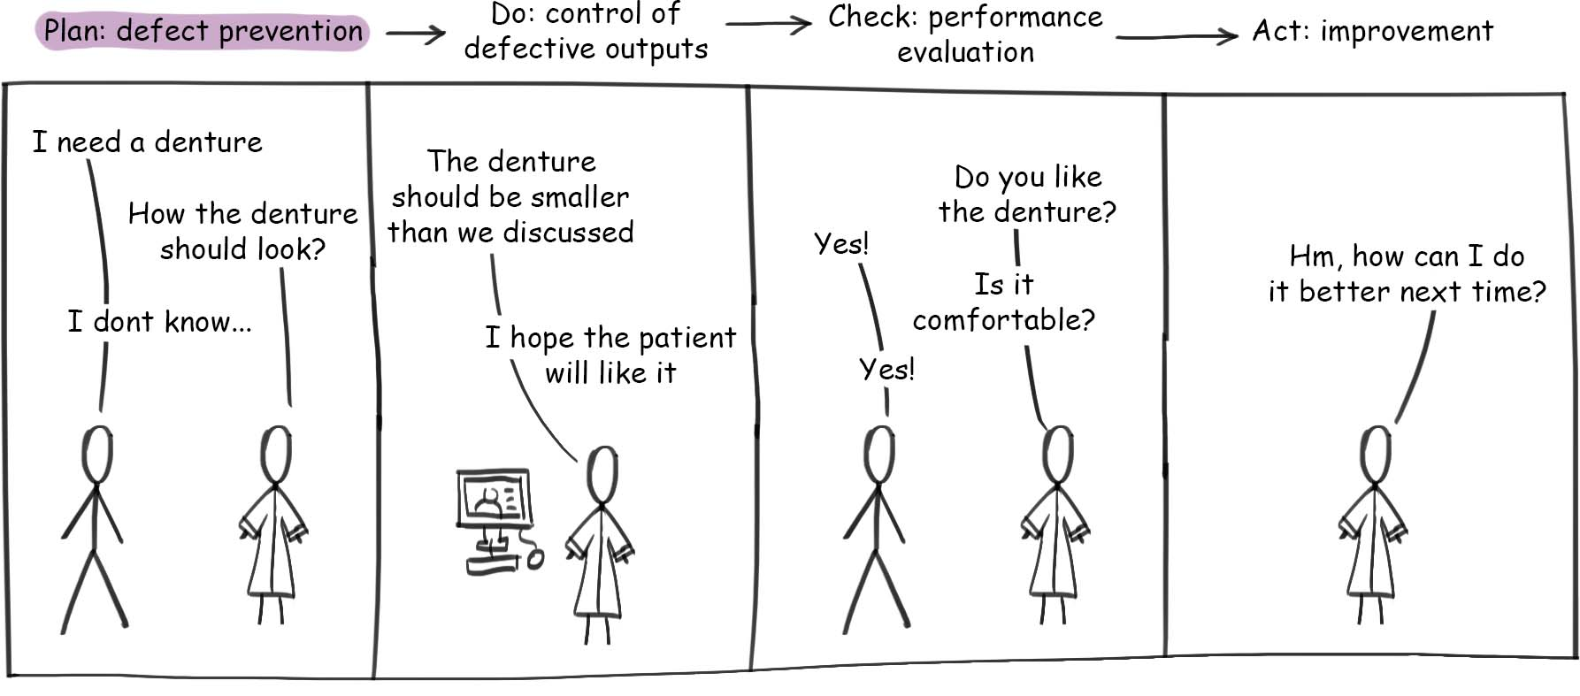

Slide 43
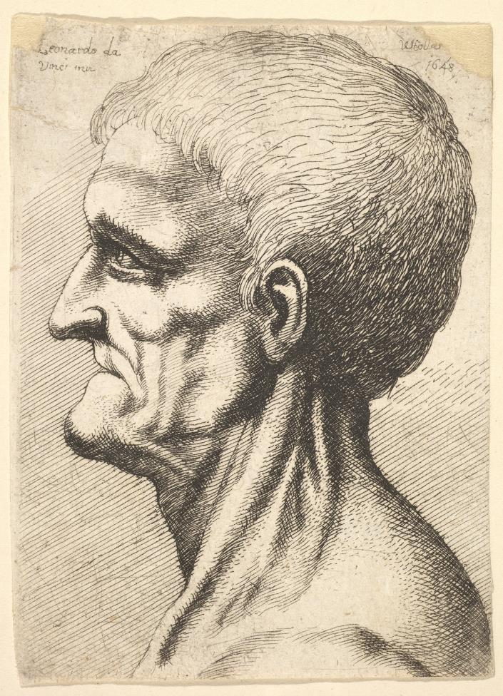
3.5 billions people are affected by oral diseases

Slide 44
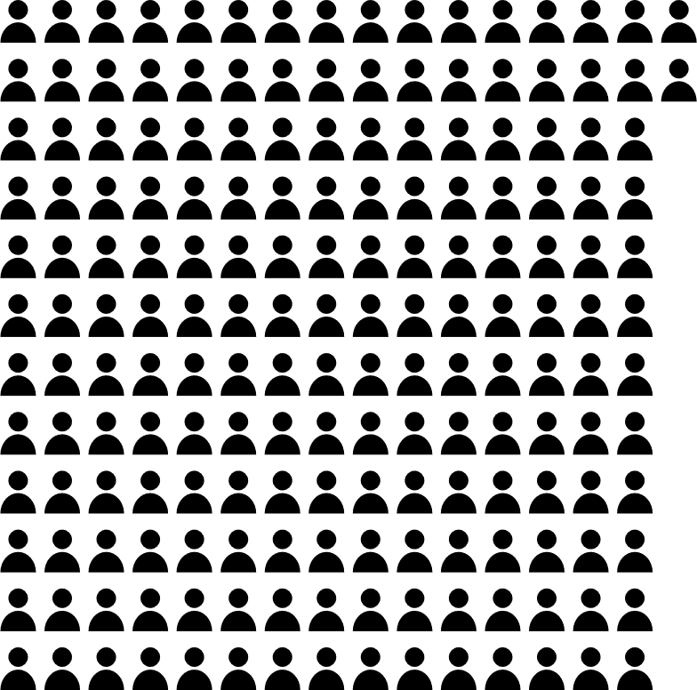
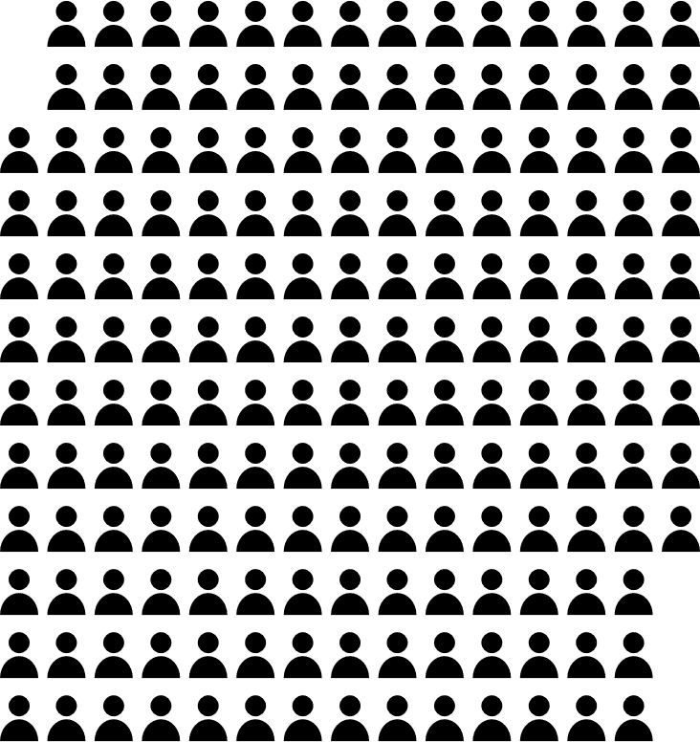
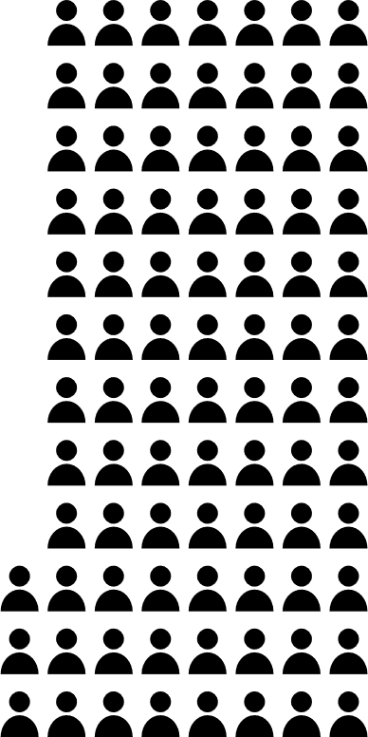
EU population

Slide 45
EU population
Have all natural teeth
Do not have all natural teeth

Slide 46
EU population
Wear dentures
Have all natural teeth
Do not have all natural teeth

Slide 47
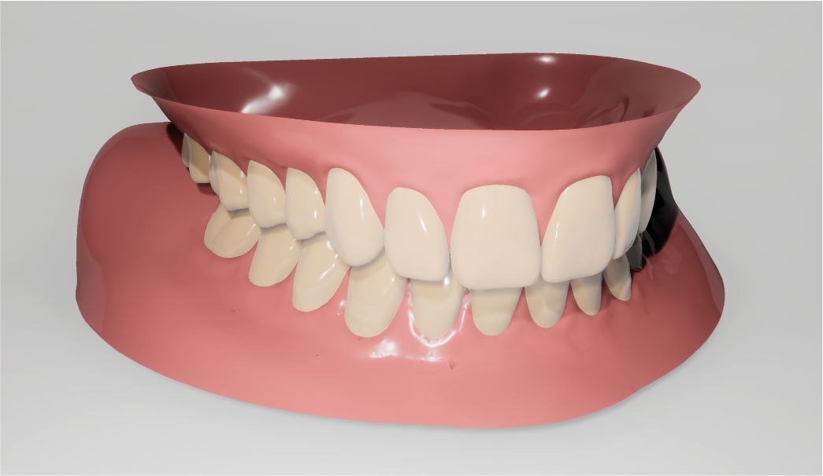
Day-to-day pain
Embarrassment
Expensive

Slide 48
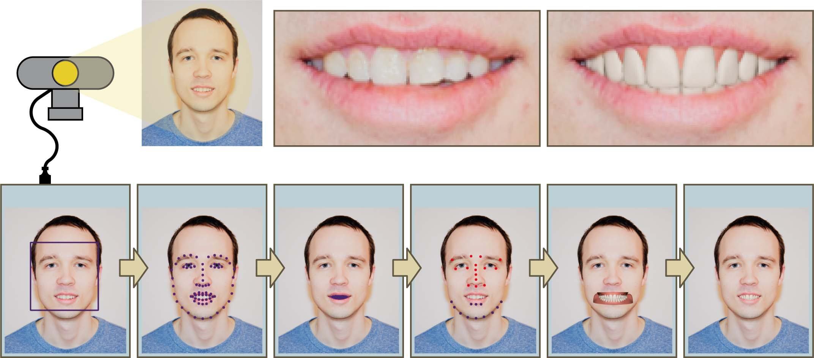
Patient
Original teeth
Virtual teeth
Face detection
Landmark
extraction
Lips detection
3D pose
estimation
Denture
placement
Rendering

Slide 49
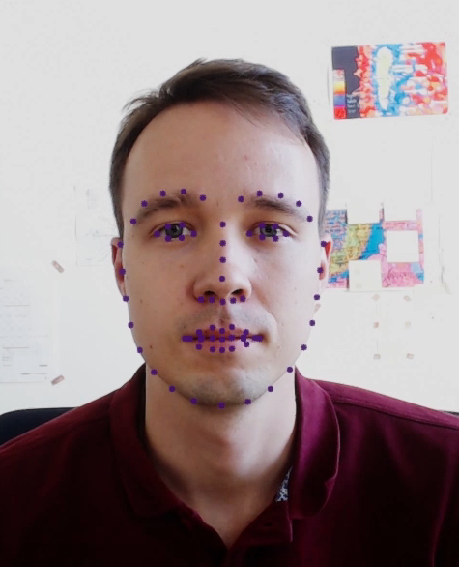
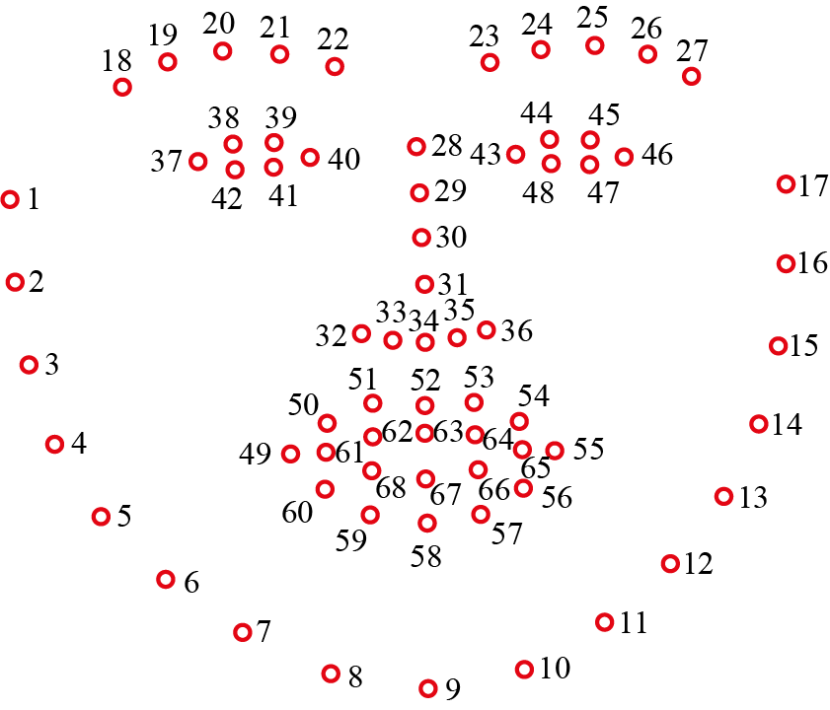

Slide 50
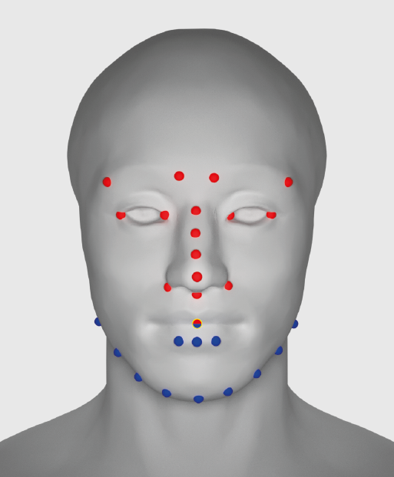
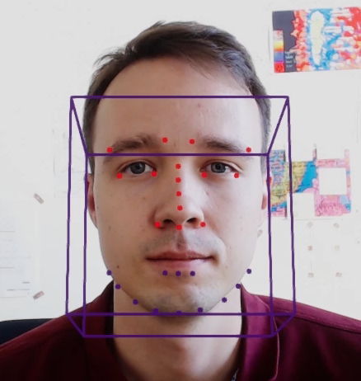

Slide 51


Slide 52
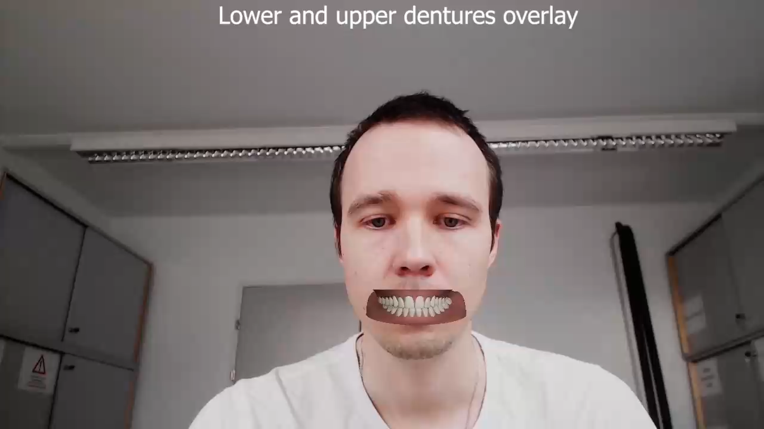

Slide 53
Impact

Slide 54
Big industrial interest
Dental design transfer
Rendering of dental models
Artificial intelligence-based imaging systems and methods for interacting with individuals via a web environment

Slide 56
Control of Defective Outputs

Slide 57
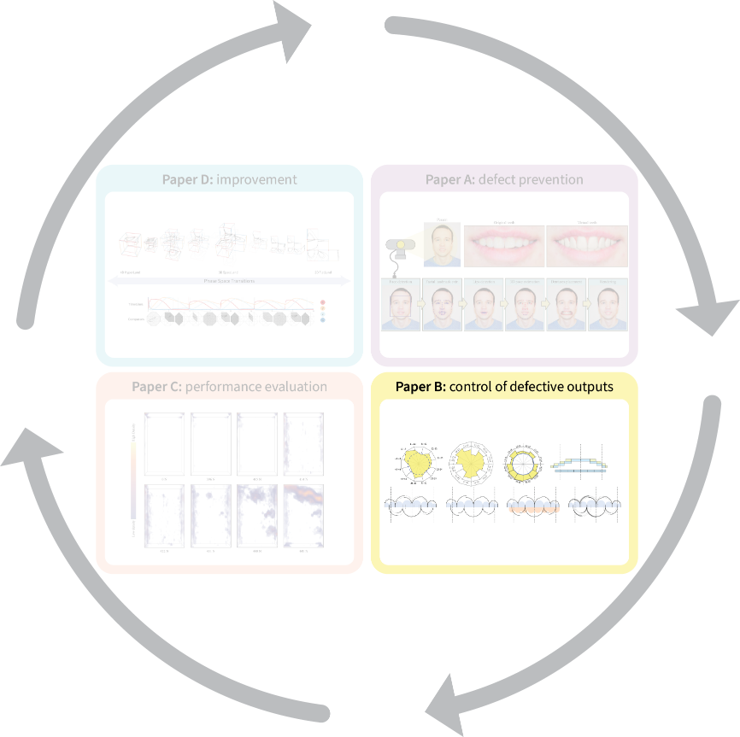
“Visual analytics in dental aesthetics,”
Computer Graphics Forum

Slide 58
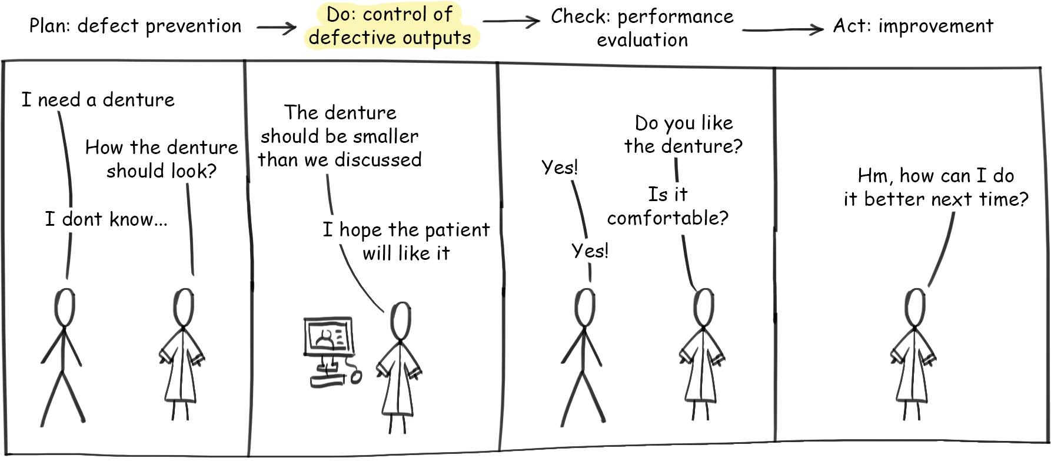

Slide 59
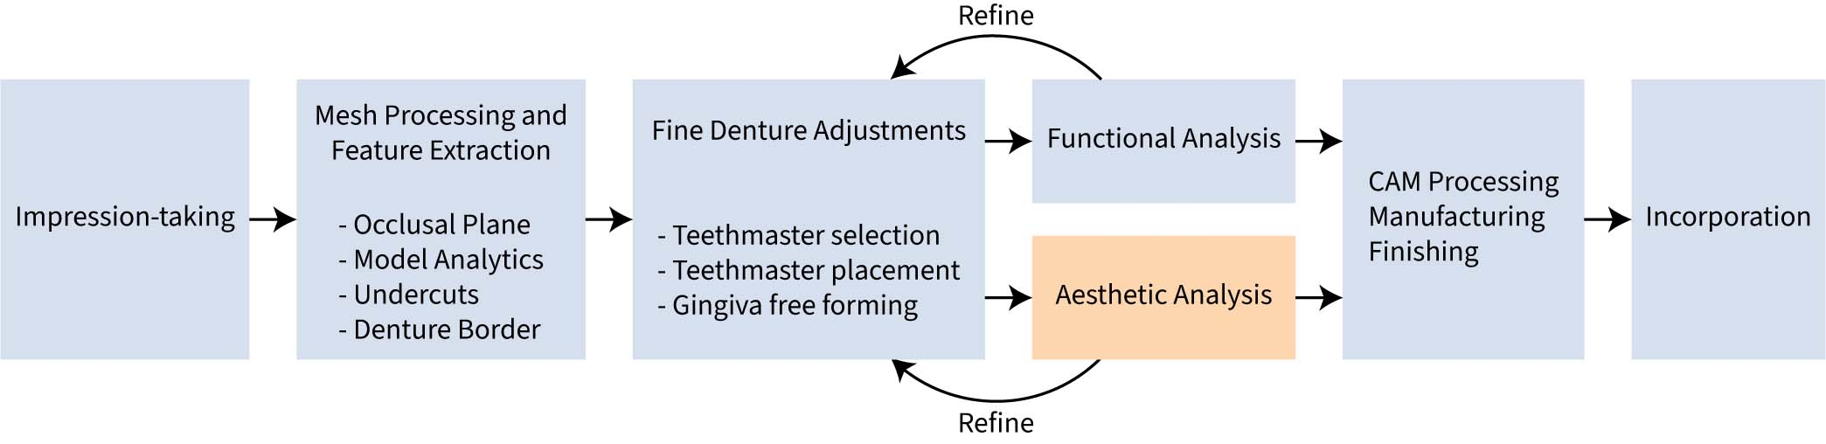

Slide 60
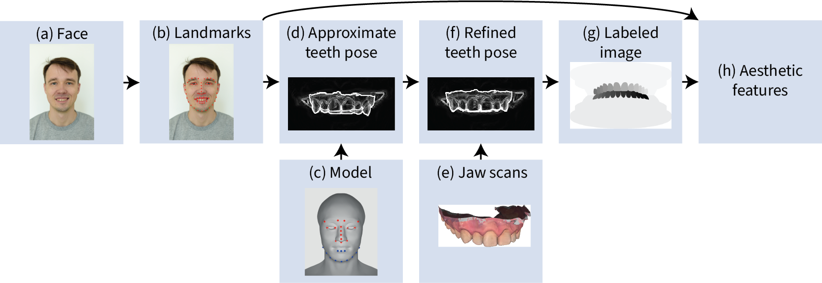

Slide 61



Slide 62
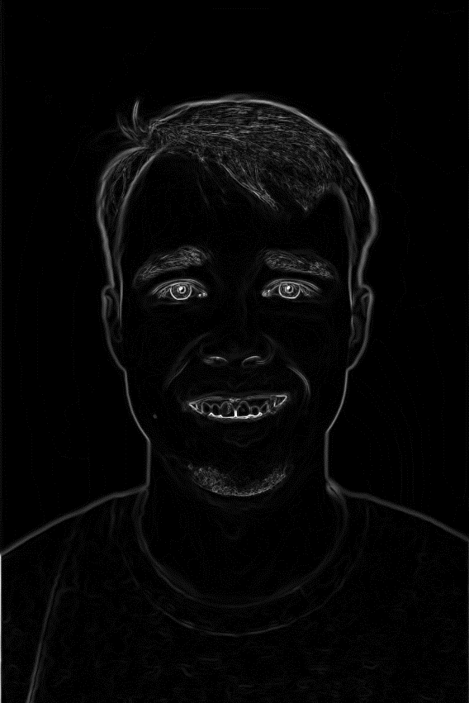


Slide 63


Slide 64
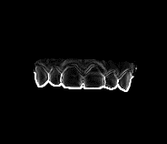
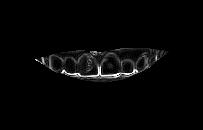

Slide 65



Slide 66
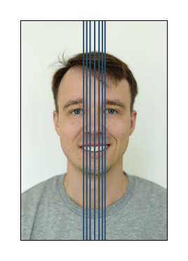
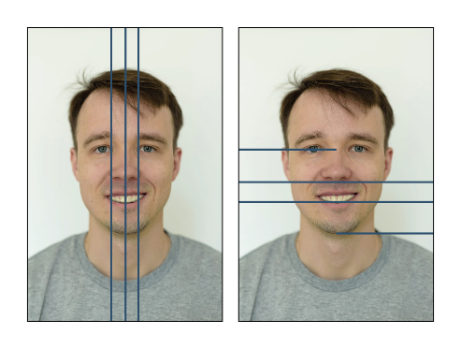





Digital implementation of
traditional techniques
Novel techniques

Slide 67


Levin, 1978

Slide 68



Slide 69


Slide 70


Slide 71
Impact

Slide 72

Integrated into state-of-the-art CAD software

Slide 74
Performance Evaluation

Slide 75

“Visual analysis of defects in glass fiber reinforced polymers for 4DCT interrupted in situ tests,”
Computer Graphics Forum

Slide 76


Boeing 787
Carbon laminate
Carbon sandwich
Fiberglass
Aluminum
Aluminum/steel/titanium pylons
Daniel, Isaac M., et al. “Engineering mechanics of composite materials,” Oxford university press, 2006.

Slide 77

l

Slide 78

Lightweight
Strong
Corrosion-resistant

Slide 79






Series of CT scans (4DCT dataset)
Test specimen
In situ tensile stage
Load
Industrial CT scanner

Slide 80



Slide 81
Dimensional metrology
Environmental conditions
Data processing
Temperature
Humidity
Reconstruction
Surface extraction
Approximations
Vibrations
Artifact correction
CT-device characteristics
Focal spot size
Intensity response
Rotary stage alignment

Slide 82


Slide 83








Slide 84

Low density
High density
0 N
414 N
431 N
440 N
449 N

Slide 85


Load

Slide 86

Cursor
Next step

Slide 87
Impact

Slide 88



My most cited work
19 citations in visualization and material science community
open_iA
Open source
Used by domain experts

Slide 90
Improvement

Slide 91

“Manylands: A journey across 4D phase space of trajectories,” Computer Graphics Forum

Slide 92


Slide 93




$$\left\{\begin{aligned}x′=f(x,y,z,w) \\ y′=g(x, y,z,w) \\ z^{′}=h(x,y,z,w) \\ w^{′}=k(x,y,z,w)\end{aligned}\right.$$
Interaction

Slide 94






1D
2D
3D
No 4D phase space visualization

Slide 95

t

Slide 96
2D
3D
4D
4D
t

Slide 97

xy
xyz
xyzw
xyzw
?
?
2D
3D
4D
4D
t

Slide 98
xy
xyz
xyzw
xyzw
?
?
?
?
?
2D
3D
4D
4D
t

Slide 99
4D HyperLand
3D SpaceLand
2D FlatLand

Slide 100


Slide 101
Impact

Slide 102




Award winning
Available online
VCBM image contest
TU Wien Magazine
Open source
Interest from
domain experts

Slide 104
Conclusion

Slide 105


[Obj1] Identify relevant visualization and visual analytics strategies

Slide 106

[Obj2] Design and develop novel strategies

Slide 107



[Obj3] Describe how the visual analysis of defects addresses different types of defects
Design space defects
Spatiotemporal defects
Temporal defects
Spatial defects

Slide 108
Outlook

Slide 109


Slide 110








Parameter space analysis
Progressiveness
Dimensionality reduction
Modern CAD software
Efficient data formats
Multidimensional visualization
Visual clutter
Trustworthiness and explainability

Slide 111
Visual analysis of defects
Defect analysis
Visual analytics

